Slide 1

Netflix Data Analysis Project
BY - Haidar Ali.

Slide 2
About the Project
This project focuses on analyzing the Netflix dataset.
Tasks included: cleaning, preprocessing, and visualization.
This project explores Netflix’s huge collection of movies and TV shows. We’ll look at trends, see which countries create the most content, and find out the most popular genres.
Goal: The goal is to uncover fun insights about Netflix’s content strategy and what people enjoy watching.

Slide 3
Our Analytical Process
Steps performed in this project:
Data Loading & Inspection
Data Cleaning (renaming columns, dropping irrelevant fields)
Handling Missing Values
Removing Duplicate Records
Exploratory Data Analysis (EDA)
Data Visualization (Graphs & Charts)
Insights & Conclusion

Slide 4
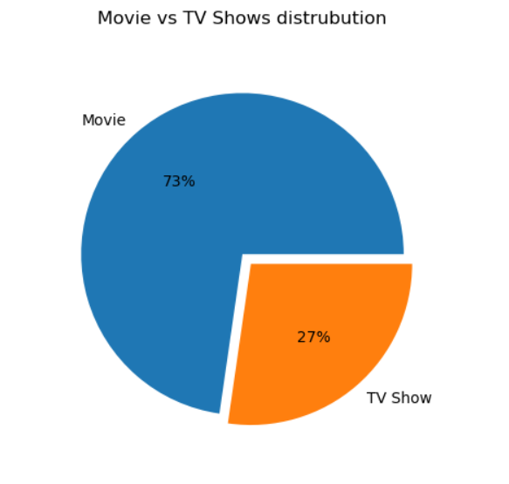
Movies vs. TV Shows
The Netflix Library: A Movie-Dominated World
Our first look at the data shows a clear winner in terms of quantity. Netflix has a significantly larger catalog of movies compared to TV shows.
Movies: Make up over 73% of the content.
TV Shows: Constitute about 27% of the library.

Slide 5
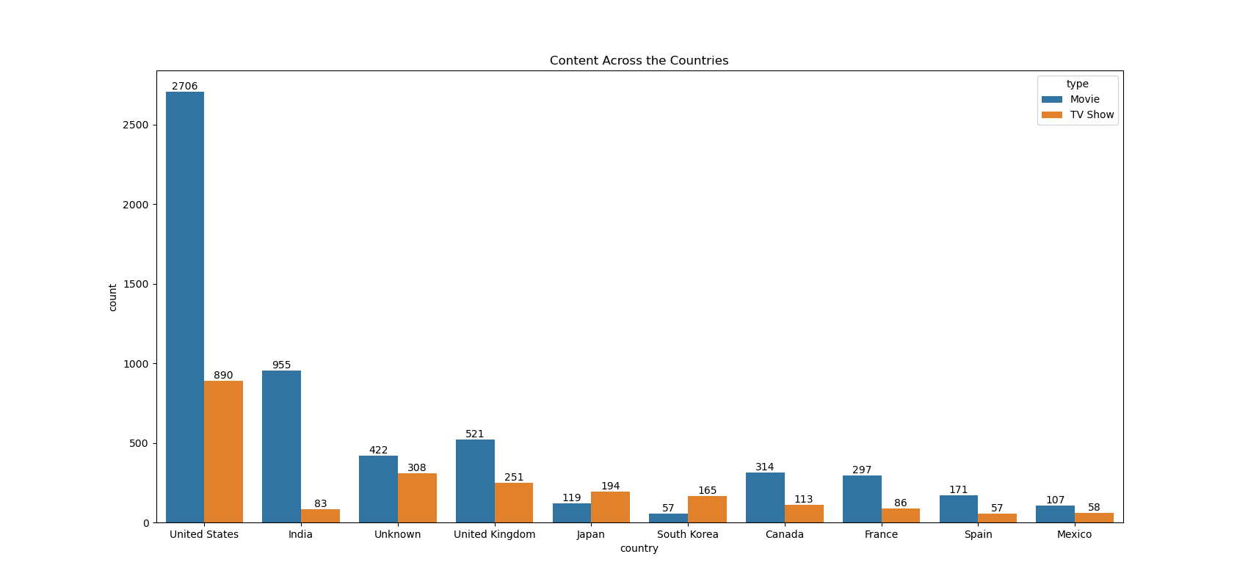
Top Content-Producing Countries
We analyzed the top 10 countries producing content for Netflix.
The United States is the top contributor by a large margin.
India follows as the second-largest producer, showcasing the importance of its film industry to the platform.

Slide 6
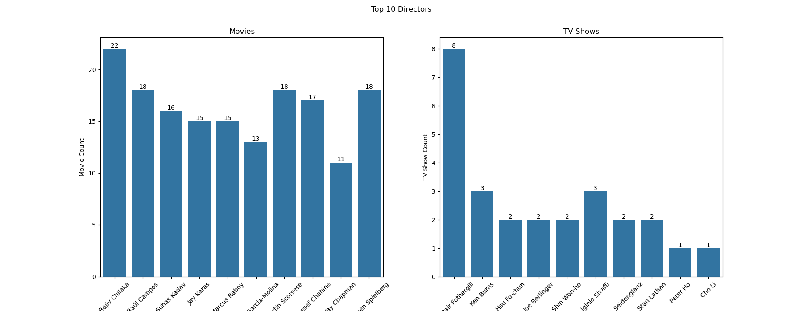
Most popular directors
Rajeev Chilaka with 22 Movies and Alastair Fothergill with 8 TV Shows stands out as the most prolific directors. Overall, the chart reveals a strong tilt toward movie direction, with most directors contributing minimally to TV Shows.

Slide 7
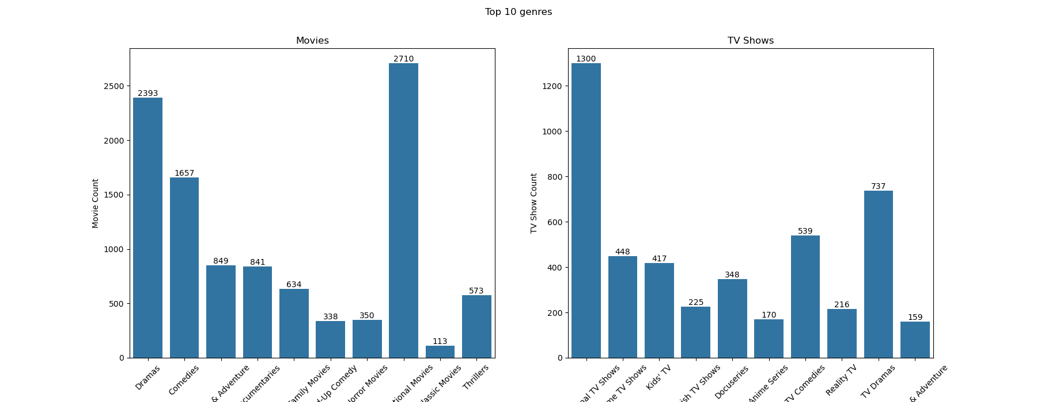
Most popular Genres
For Movies: Dramas, International Movies, and Comedies are the most frequent genres
For TV Shows: International TV Shows, TV Dramas, and TV Comedies lead the pack.

Slide 8
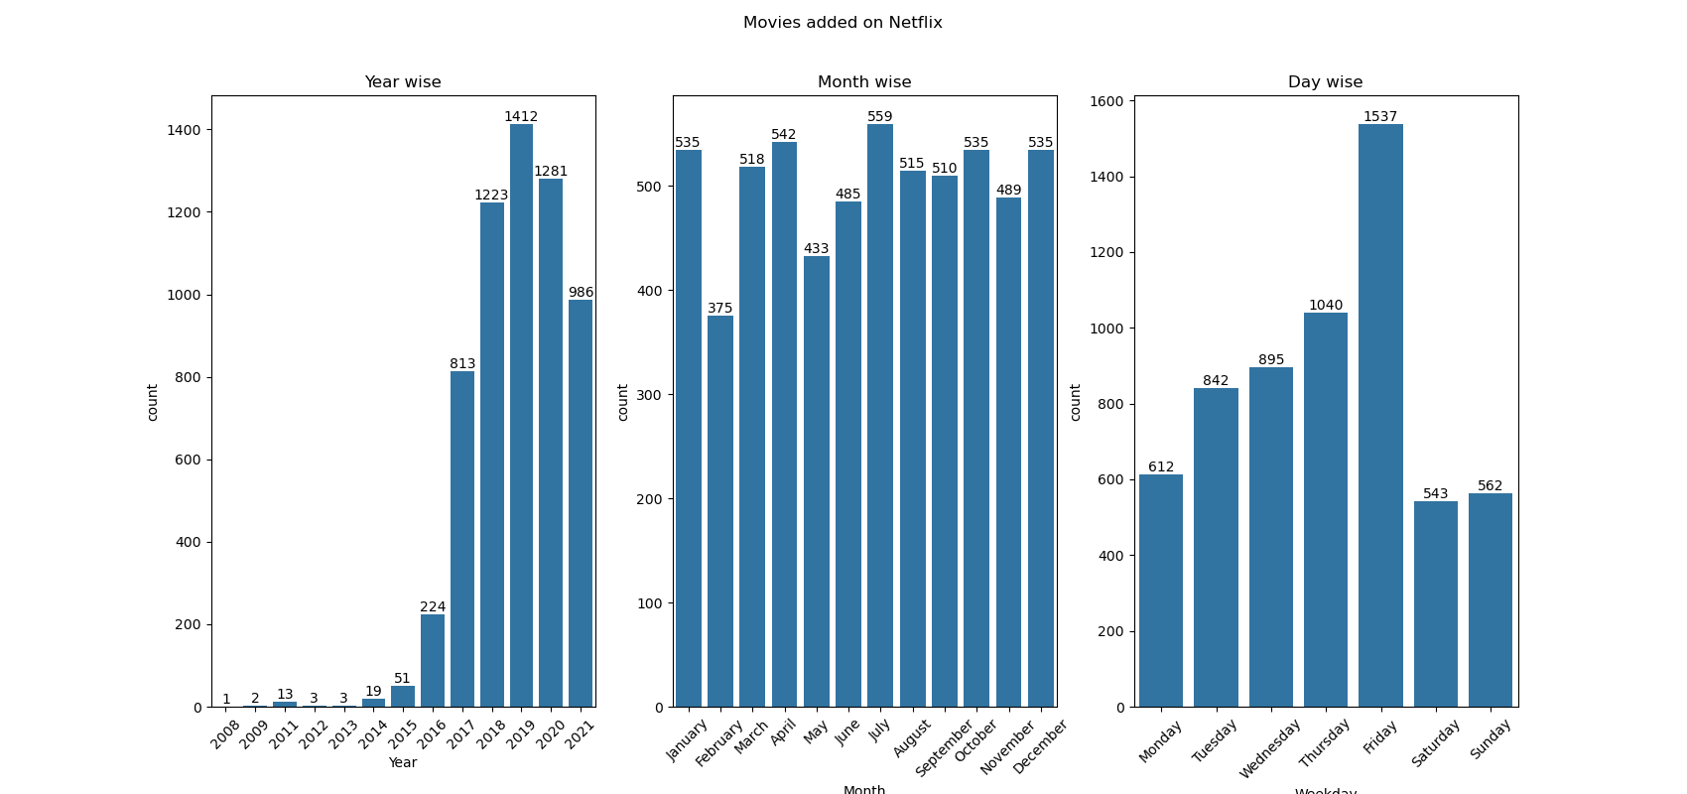
The Growth of Netflix – added movies
This chart shows the trend of content being added to Netflix over the years.
There is a dramatic exponential increase in content added from 2016 onwards.
This surge highlights Netflix's aggressive expansion and investment in content acquisition and production in recent years.

Slide 9
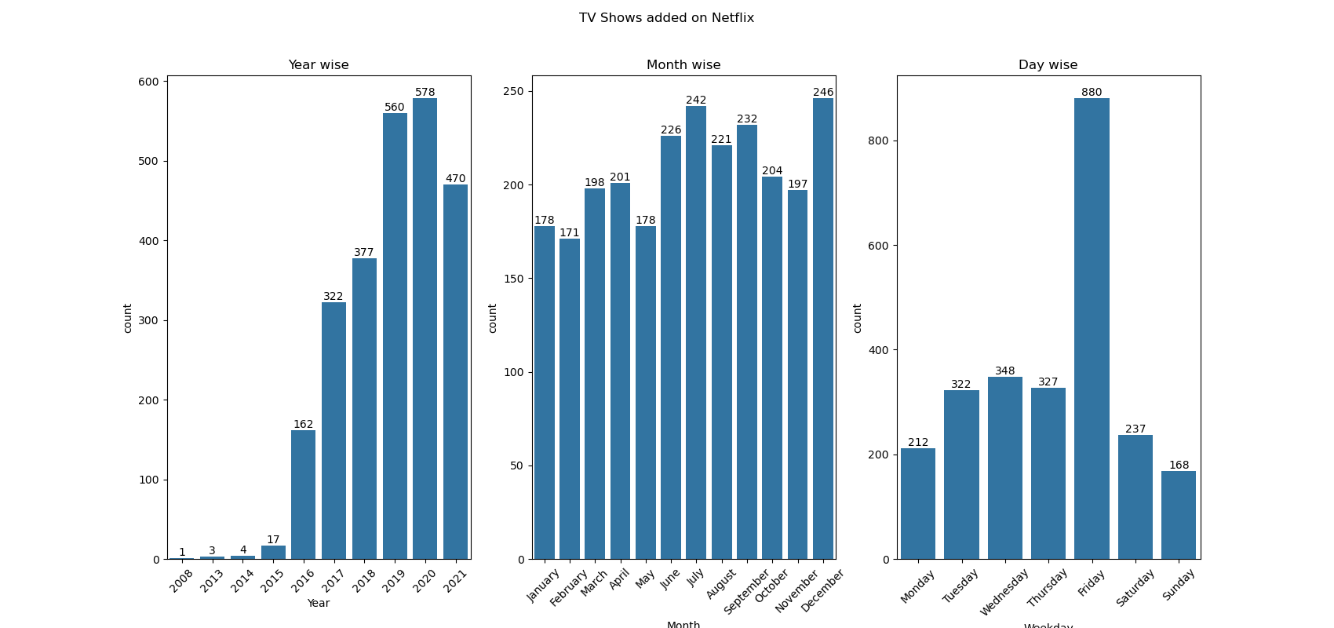
The Growth of Netflix – added TV Shows
This chart shows the trend of content being added to Netflix over the years.
There is a dramatic exponential increase in content added from 2016 onwards.
This surge highlights Netflix's aggressive expansion and investment in content acquisition and production in recent years.

Slide 10
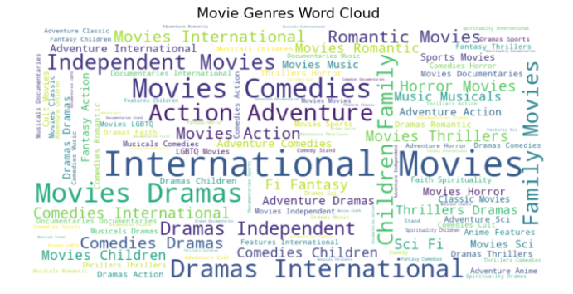
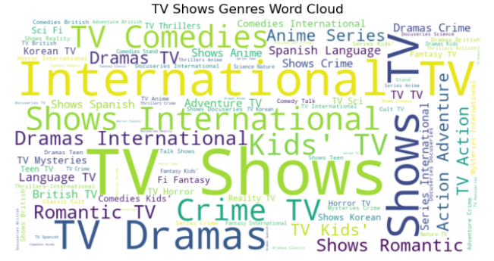
Genre Word Clouds
Visualizing Genre Popularity
These word clouds show the most common words in genre descriptions. Bigger words appear more often, which supports what we saw in the previous slide.

Slide 11
Conclusion --- Key Insights
Summary: In this project, we worked with the data step by step: collecting it, cleaning it, studying it, and creating visuals to understand it better.
Technical Showcase: Showed skills in using Pandas to prepare data, Matplotlib/Seaborn/Plotly to make graphs, and creating useful features for better analysis.
Business Insight: Netflix mainly focuses on movies, makes content worldwide, is growing quickly, and mostly targets adult viewers.
The United States and India are the primary content powerhouses for the platform.
The platform experienced explosive growth in its content library starting around 2016.

Slide 12
Thank you!

